Slide 1
Build an Emezzin’ Enterprisin’ Rockstar Solution
With
Gemma Emmett Charly Prinsloo Susannah St-Germain
@gemziebeth @charlyprinsloo @sunnydalelow

Slide 2
Forward-Looking Statement
Statement under the Private Securities Litigation Reform Act of 1995
This presentation may contain forward-looking statements that involve risks, uncertainties, and assumptions. If any such uncertainties materialize or if any of the assumptions proves incorrect, the results of salesforce.com, inc. could differ materially from the results expressed or implied by the forward-looking statements we make. All statements other than statements of historical fact could be deemed forward-looking, including any projections of product or service availability, subscriber growth, earnings, revenues, or other financial items and any statements regarding strategies or plans of management for future operations, statements of belief, any statements concerning new, planned, or upgraded services or technology developments and customer contracts or use of our services.
The risks and uncertainties referred to above include – but are not limited to – risks associated with developing and delivering new functionality for our service, new products and services, our new business model, our past operating losses, possible fluctuations in our operating results and rate of growth, interruptions or delays in our Web hosting, breach of our security measures, the outcome of any litigation, risks associated with completed and any possible mergers and acquisitions, the immature market in which we operate, our relatively limited operating history, our ability to expand, retain, and motivate our employees and manage our growth, new releases of our service and successful customer deployment, our limited history reselling non-salesforce.com products, and utilization and selling to larger enterprise customers. Further information on potential factors that could affect the financial results of salesforce.com, inc. is included in our annual report on Form 10-K for the most recent fiscal year and in our quarterly report on Form 10-Q for the most recent fiscal quarter. These documents and others containing important disclosures are available on the SEC Filings section of the Investor Information section of our Web site.
Any unreleased services or features referenced in this or other presentations, press releases or public statements are not currently available and may not be delivered on time or at all. Customers who purchase our services should make the purchase decisions based upon features that are currently available. Salesforce.com, inc. assumes no obligation and does not intend to update these forward-looking statements.
Notes:
Key Message Salesforce is a publicly traded company. Customers should make buying decisions only on the products commercially available.
Talk Track Before I begin, just a quick note that you should base your purchasing decisions on products and services that are currently available.

Slide 3
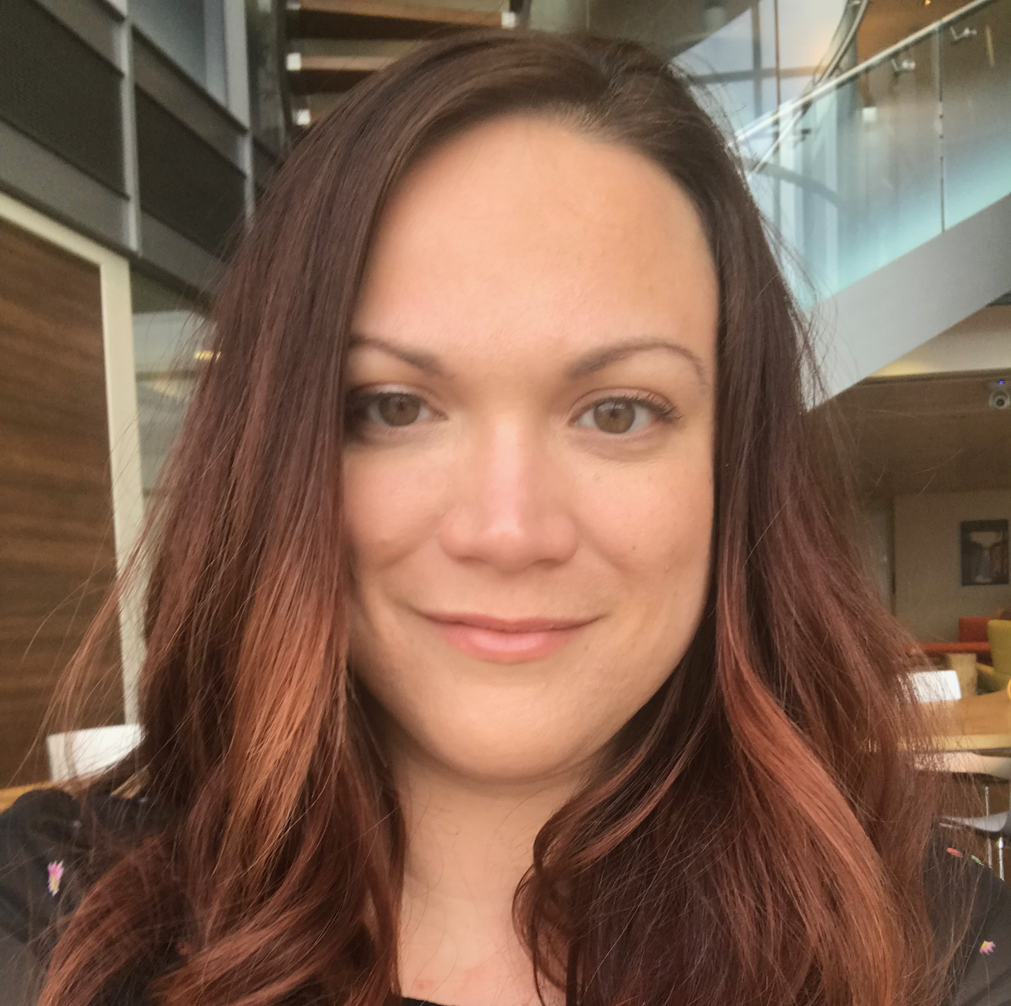
Gemma Emmett
Solution Architect Manager
Bluewolf, an IBM Company
Charly Prinsloo
Technical Architect
Deloitte Digital
Susannah St-Germain
Technical Architect
Boston Scientific

Slide 4
Objectives
De-mystify the process
Challenge your time management skills
Help you see it’s achievable
Build your network
Have a jolly good time

Slide 5
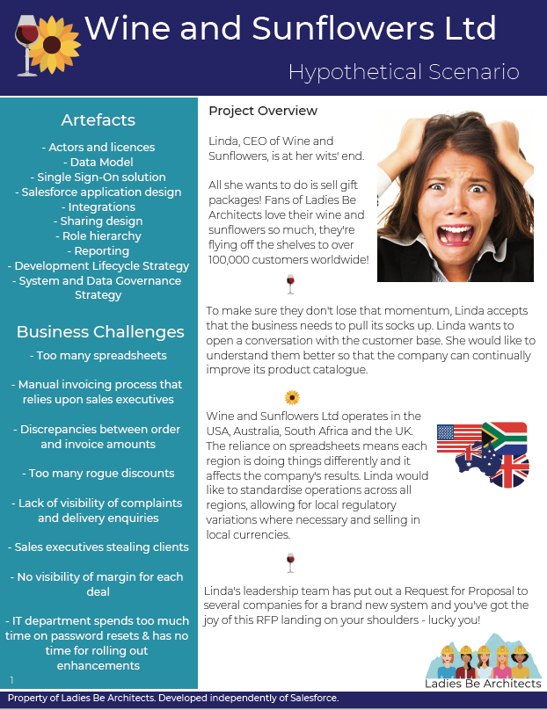
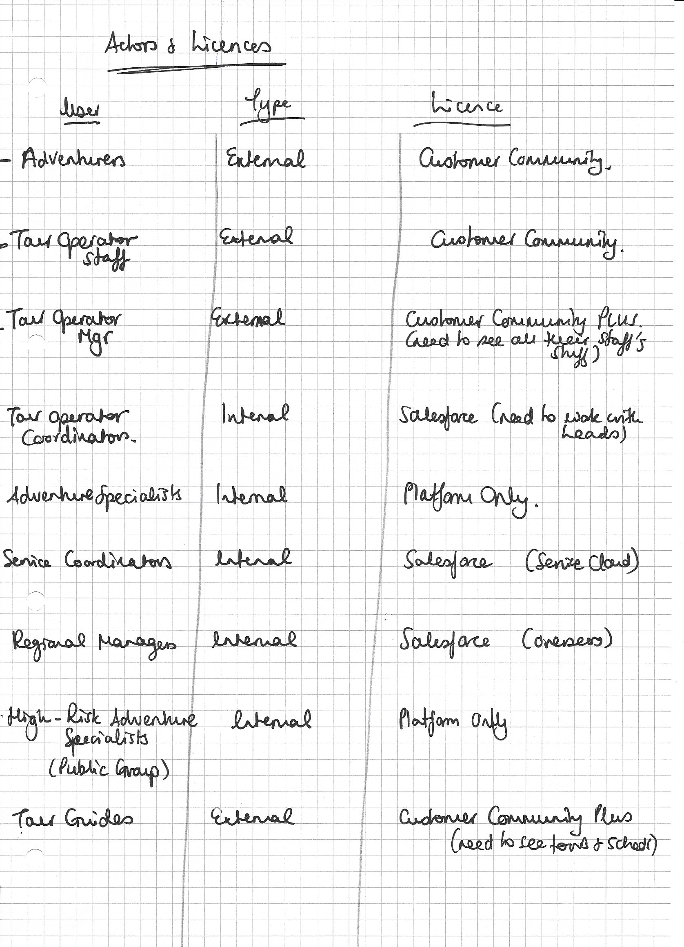
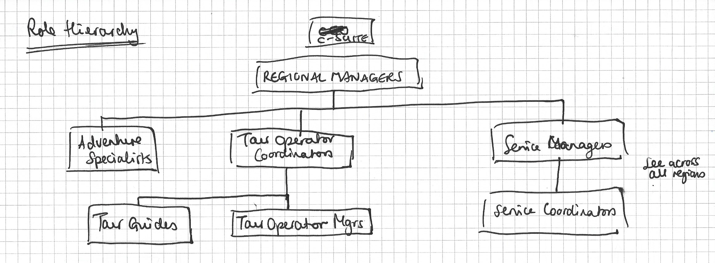
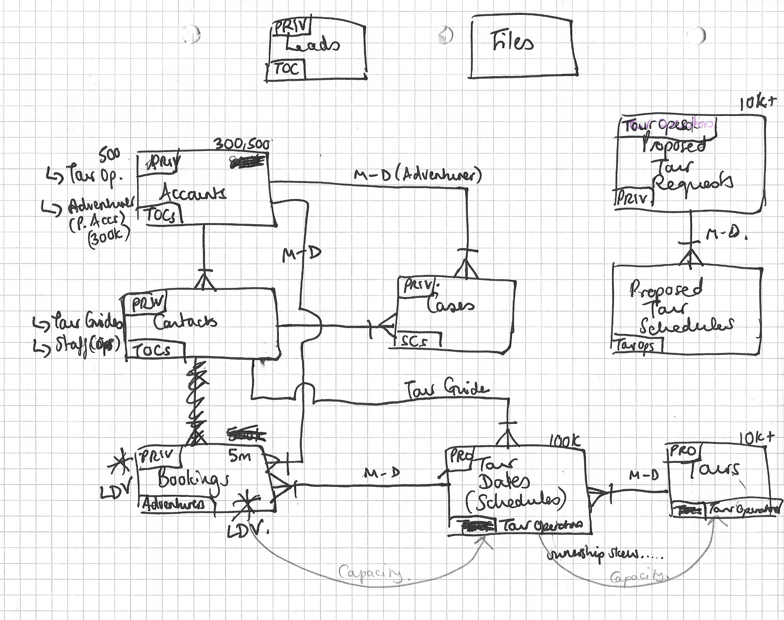
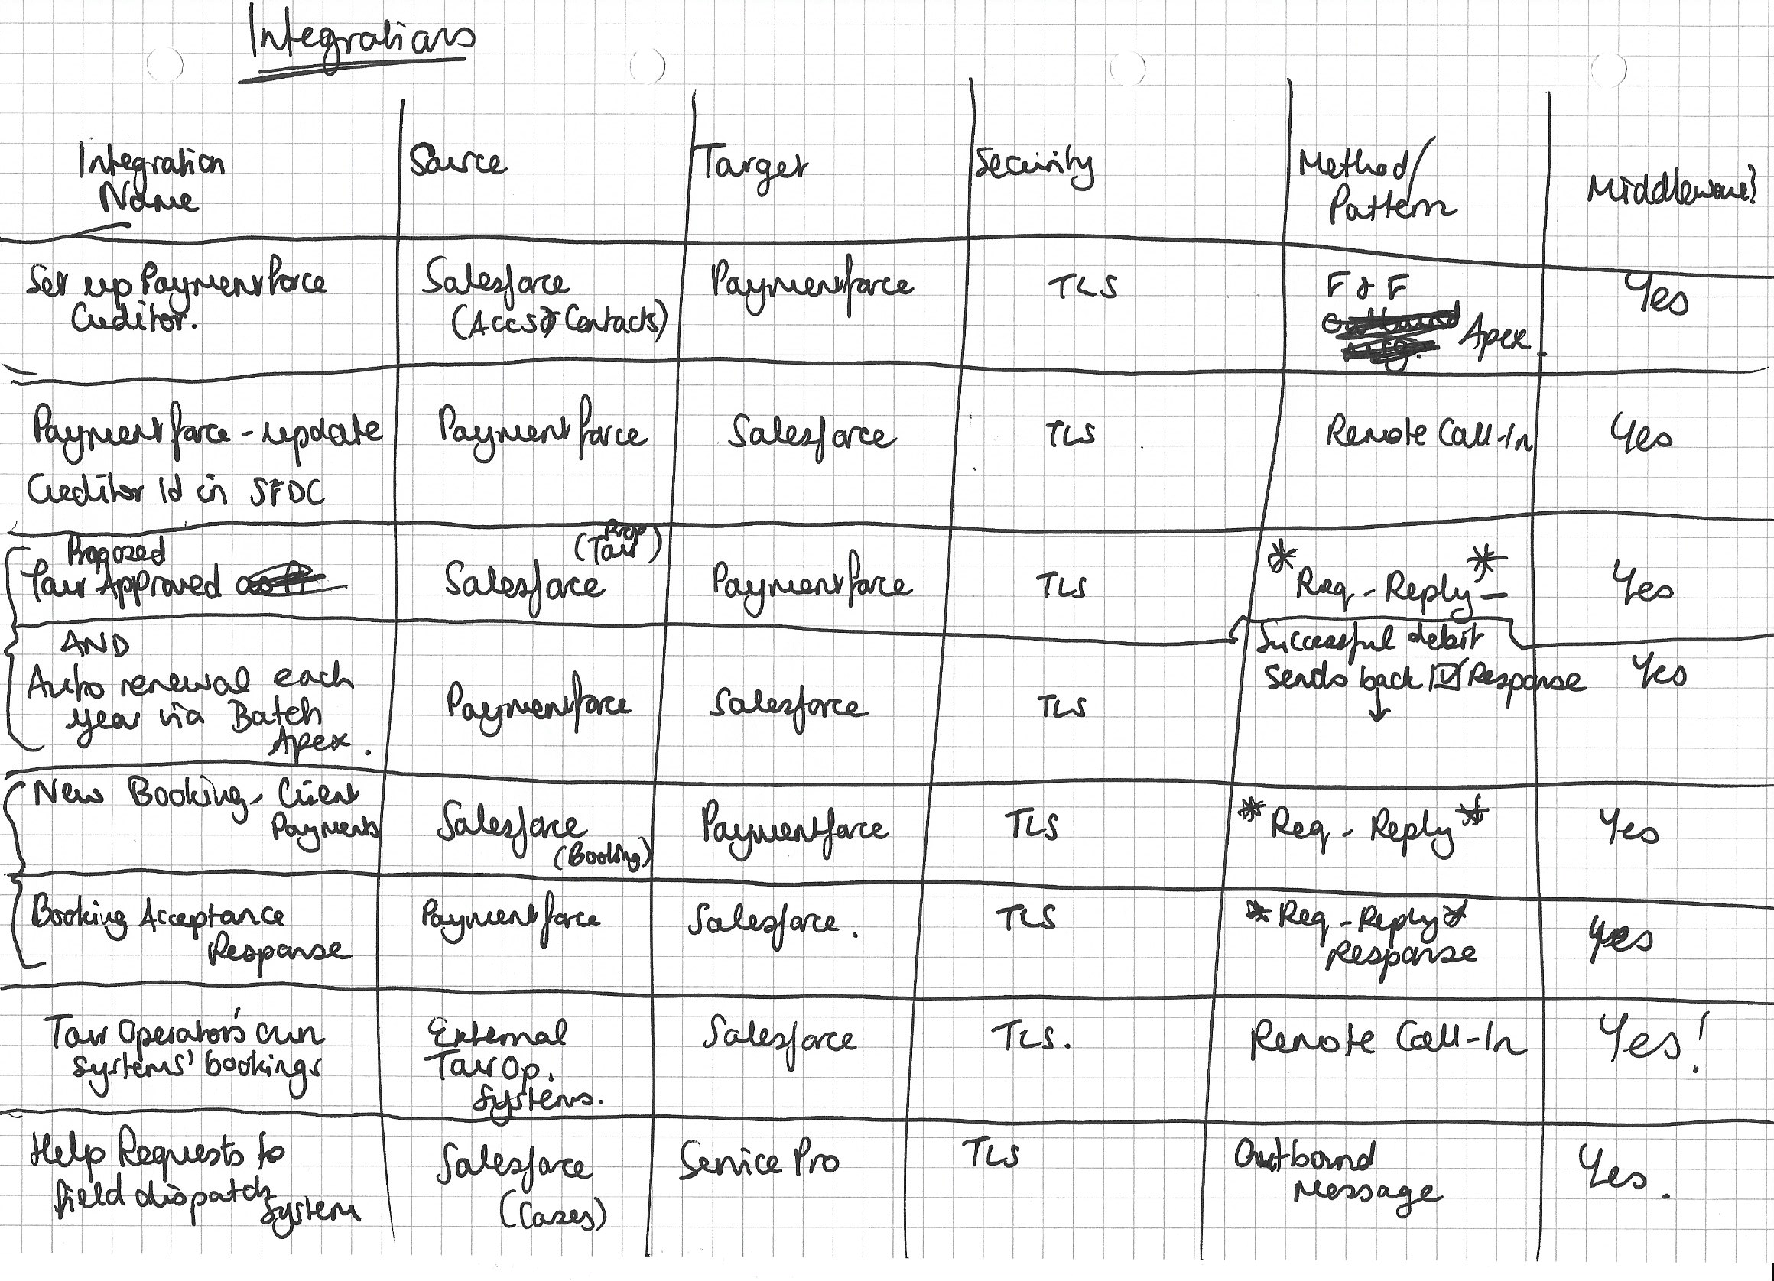
What To Do
Each row has been given an envelope containing the same scenario. Don’t open it until instructed.
You have 15 minutes to read through the whole scenario, solve it for your area and prepare your allocated “artefact”
Choose any format you like to present your solution
Talk to other teams!
Role Hierarchy
Data Model
Integrations
Actors & Licenses

Slide 6
You will have 2 minutes to present your artefact
Choose a group leader to present

Slide 7
Rules
Time limits are there on purpose 😈
We recommend you move freely around the room and talk to other teams.
When told, everyone must stop working / presenting promptly
Sadly, we don’t have time for Q&A.
If you've got any questions, contentions or discussion points, write them up in your Parking Lot. Feel free to discuss them over lunch
Play nicely and respect one another’s opinions :0)

Slide 8
Artefacts
List of actors and licenses
Data model
Single Sign-On solution
Salesforce application design
Integrations
Sharing design
Role hierarchy
Reporting
Development Lifecycle Strategy
System and Data Governance Strategy
Role Hierarchy
Data Model
Integrations
Actors & Licenses

